Slide 1
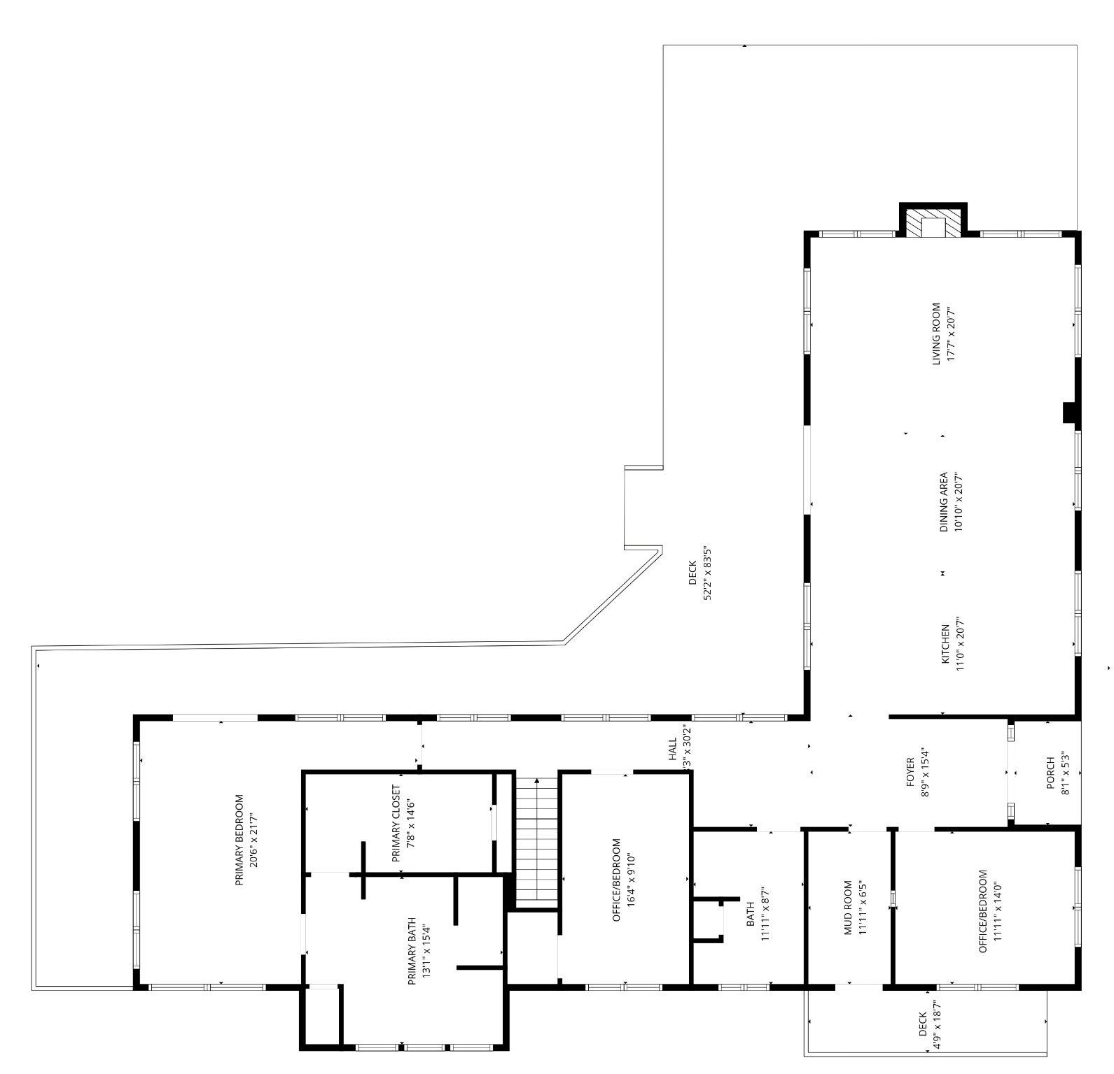

White Horse Hill Farm
19/23 White Horse Hill Lane, Amissville
23 White Horse Hill - Main Level
37C Main Street ● Sperryville, VA 22740
540.987.8500 ● www.cheriwoodard.com
Measurements deemed reliable but not guaranteed. For reference purposes only.

Slide 2
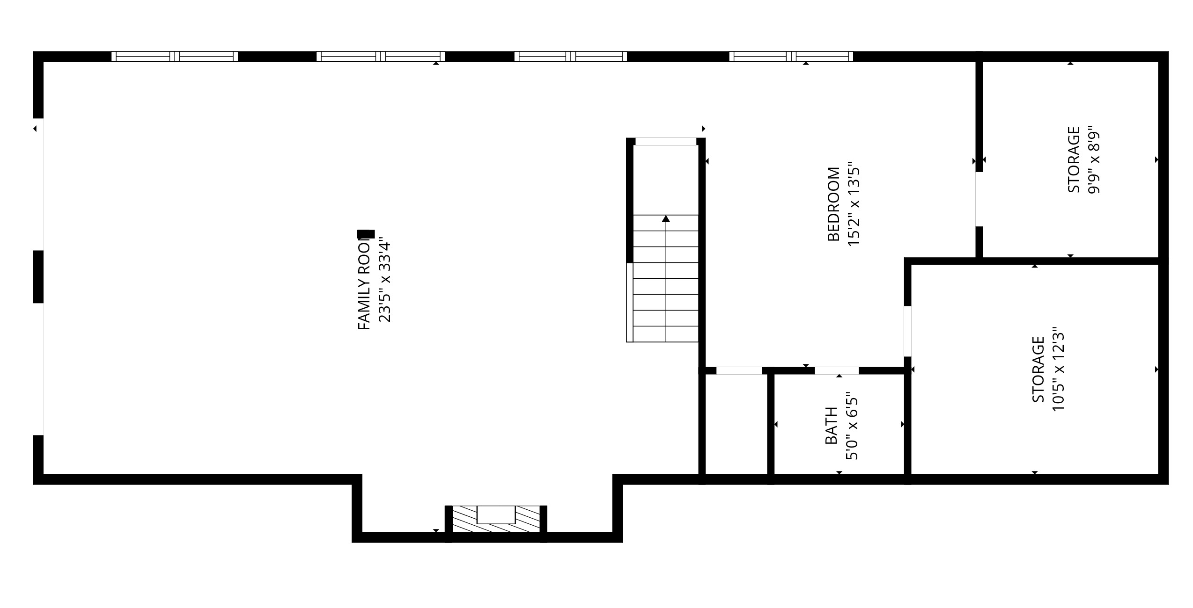
White Horse Hill Farm
19/23 White Horse Hill Lane, Amissville
23 White Horse Hill - Lower Level
37C Main Street ● Sperryville, VA 22740
540.987.8500 ● www.cheriwoodard.com
Measurements deemed reliable but not guaranteed. For reference purposes only.

Slide 3
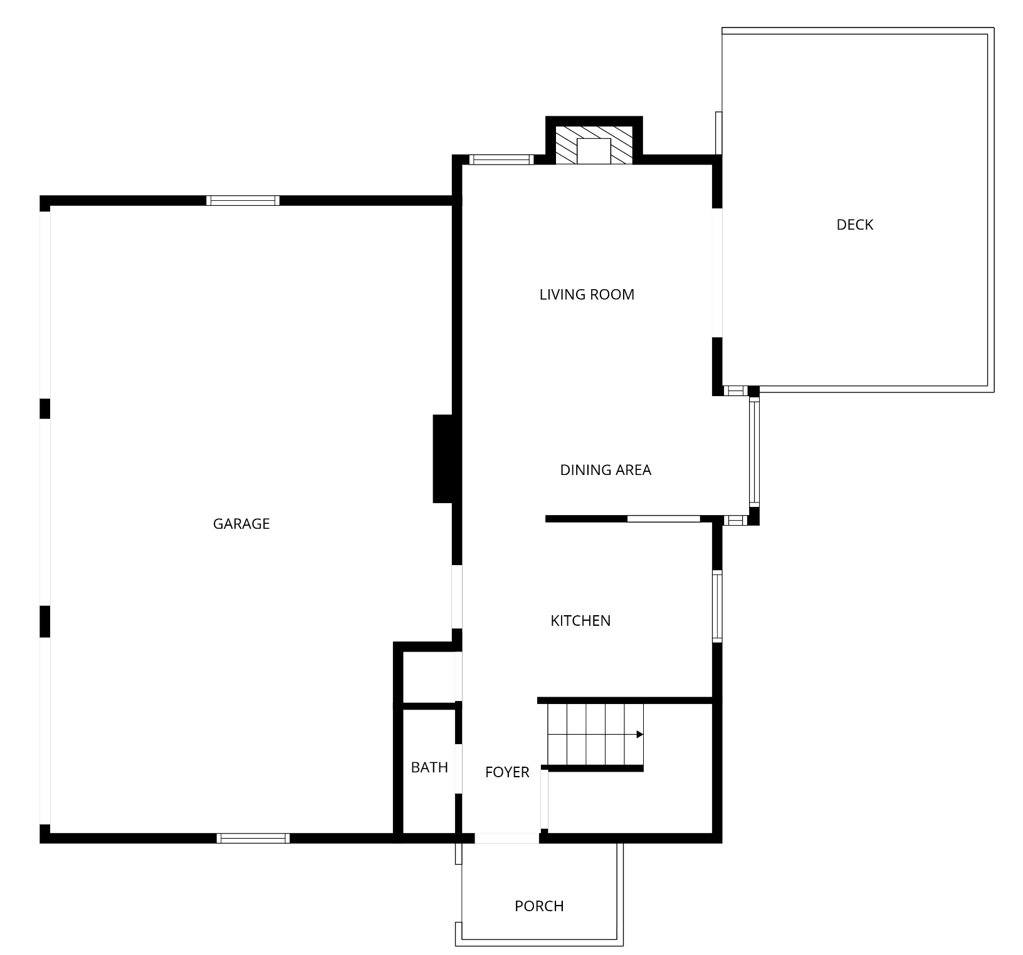
White Horse Hill Farm
19/23 White Horse Hill Lane, Amissville
19 White Horse Hill - Main Level
37C Main Street ● Sperryville, VA 22740
540.987.8500 ● www.cheriwoodard.com
Measurements deemed reliable but not guaranteed. For reference purposes only.

Slide 4
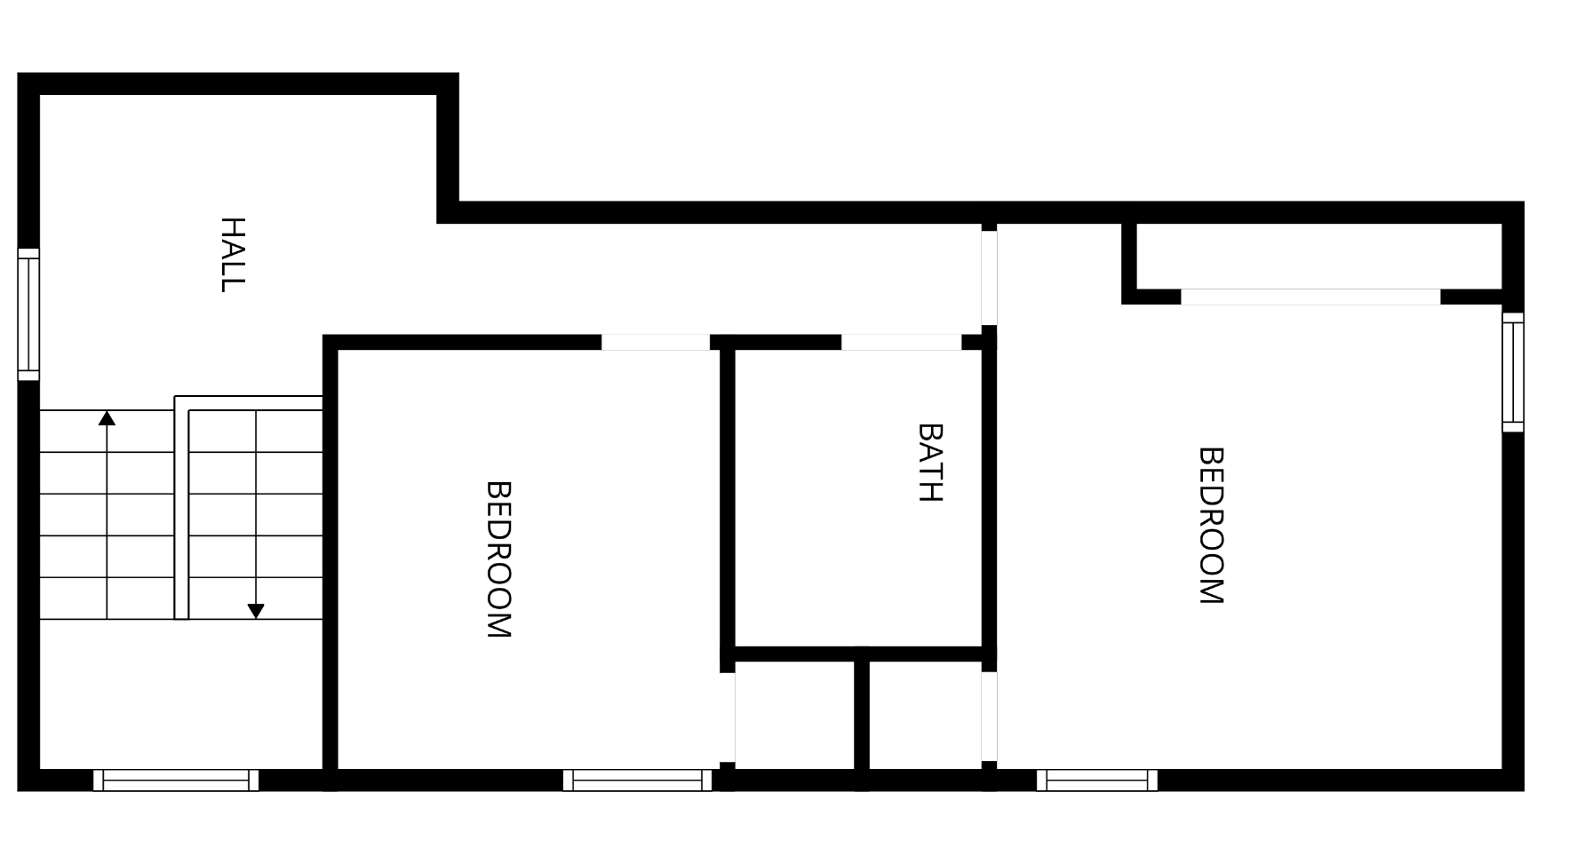
White Horse Hill Farm
19/23 White Horse Hill Lane, Amissville
19 White Horse Hill – Upper Level
37C Main Street ● Sperryville, VA 22740
540.987.8500 ● www.cheriwoodard.com
Measurements deemed reliable but not guaranteed. For reference purposes only.

Slide 5
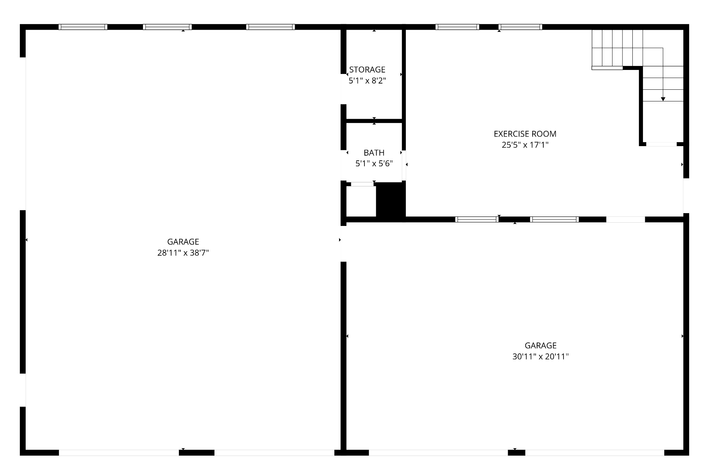
White Horse Hill Farm
19/23 White Horse Hill Lane, Amissville
Car Barn - Main Level
37C Main Street ● Sperryville, VA 22740
540.987.8500 ● www.cheriwoodard.com
Measurements deemed reliable but not guaranteed. For reference purposes only.

Slide 6
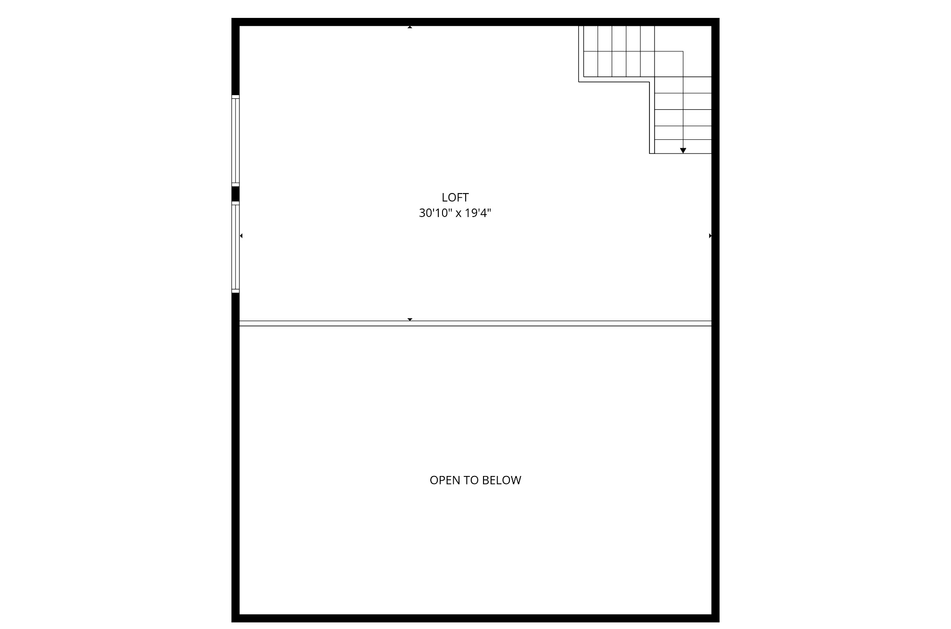
White Horse Hill Farm
19/23 White Horse Hill Lane, Amissville
Car Barn - Upper Level
37C Main Street ● Sperryville, VA 22740
540.987.8500 ● www.cheriwoodard.com
Measurements deemed reliable but not guaranteed. For reference purposes only.

